Slide 1
DM TA Session 5
Hanwen Serena Xu
hanwen@uchicago.edu

Slide 2
Contents
Homework 3
Decision Tree
SVM
How to deal with missing data
Pycaret

Slide 3
HW3
Please watch the titanic review recording. The titanic part tarts at 1:20:00.
It’s very helpful for feature engineering including how to handle missing values.

Slide 4
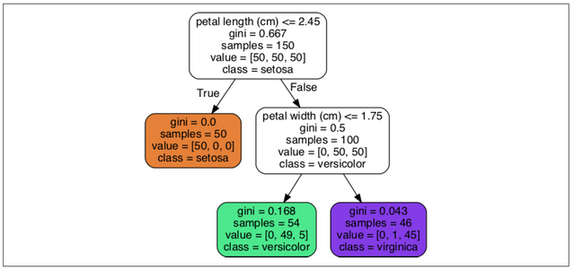
Decision Tree
DT are versatile Machine Learning algorithms that can perform both classification and regression tasks
DT are also the fundamental components of Random Forests
DT require very little data preparation. In fact, they don’t require feature scaling or centering at all

Slide 5
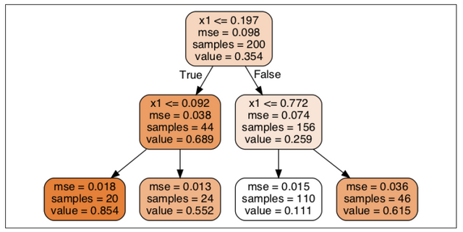
Decision Tree
DT also perform regressions, also known as regression tree
The main difference is that instead of predicting a class in each node, it predicts a value
https://www.youtube.com/watch?v=g9c66TUylZ4

Slide 6
Decision Tree - hyperparameters
max_depth (the maximum depth of the tree)
min_samples_split (the minimum number of samples a node must have before it can be split)
min_samples_leaf (the minimum number of samples a leaf node must have)
min_weight_fraction_leaf (same as min_samples_leaf but expressed as a fraction of the total number of weighted instances)
max_leaf_nodes (the maximum number of leaf nodes)
max_features (the maximum number of features that are evaluated for splitting at each node)
impurity (the function to measure the quality of a split)

Slide 7
Decision Tree – pros & cons
ADVANTAGES OF DECISION TREES
Simple, easy to explain, very fast
A good starting point of the analysis
Minimum preprocessing of data
DISADVANTAGES OF DECISION TREES
Do not achieve a state-of-the-art results
Deep trees tend to have high variance (and low bias) and shallow trees tend to be overly bias (but low variance)
Small change in data can give you completely different results

Slide 8
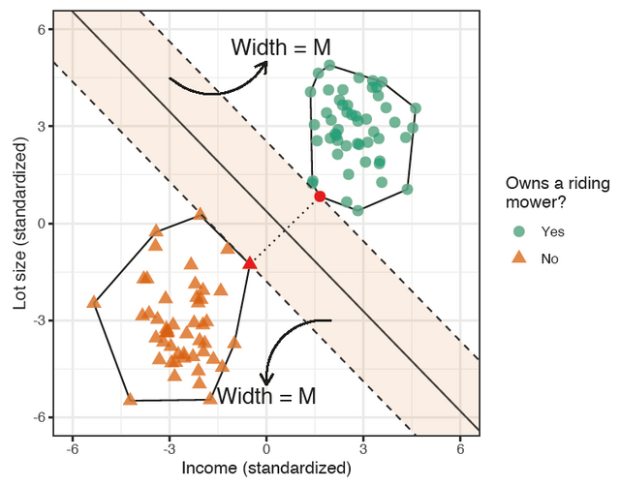
SVM
Hard margin classifier
HMC finds the separating hyperplane that provides the largest margin/gap between the two classes

Slide 9
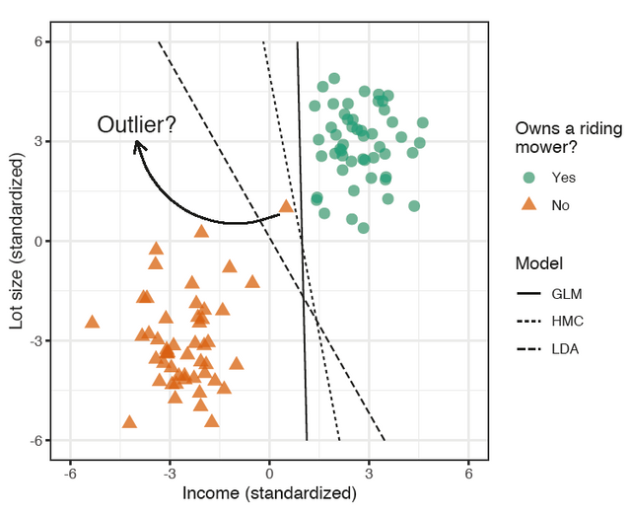
SVM
Hard margin classifier
HMC finds the separating hyperplane that provides the largest margin/gap between the two classes

Slide 10
SVM
sOFT margin classifier
In some situations, HMC will not perform well
Find a good balance between keeping the street as large as possible and limiting the margin violations
We can loosen the constraints (or soften the margin) by allowing some points to be on the wrong side of the margin; this is referred to as the soft margin classifier
SMC finds the separating hyperplane that provides the largest margin/gap between the two classes, but allows for some of the points to cross over the margin boundaries
C is the allowable budget for the total amount of overlap and is our first tunable hyperparameter for the SVM
C is a parameter, which allows us to control how tight/loosen is our classifier

Slide 11
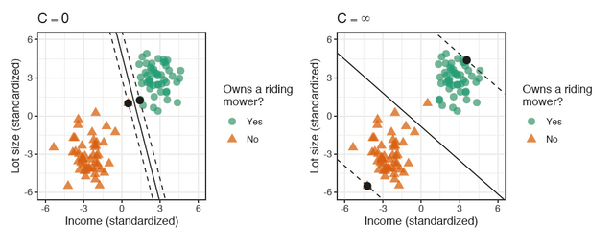
Examples of Different Cs
Left: Zero budget for overlap (i.e., the HMC).
Right: Maximum allowable overlap. The solid black points represent the support vectors that define the margin boundaries
If your SVM model is overfitting, you can try regularizing it by increasing C

Slide 12
Examples of Different Cs
The hyperparameter c in sklearn is not the same as what we discussed in learning the algorithm
C in sklearn: Regularization parameter. The strength of the regularization is inversely proportional to C. Must be strictly positive.
A smaller c: wider street, more margin violation
A higher c: smaller margin, fewer margin violations
If overfit, lower c in sklearn

Slide 13
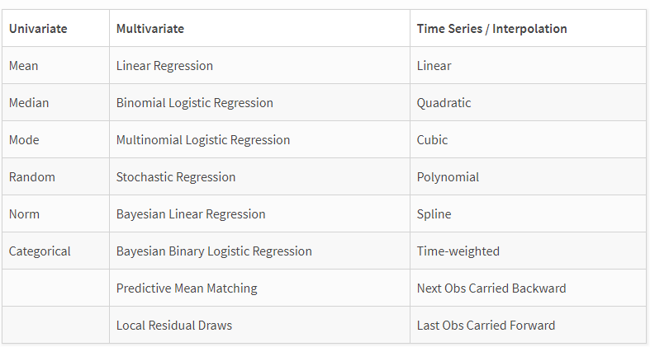
How to deal with missing values

Slide 14
How to deal with missing values
https://pypi.org/project/autoimpute/

Slide 15
Pycaret
Set a baseline for further analysis

Slide 16
Questions?

Slide 17
Recommended sources
Hands-On Machine Learning with R (Boehmke & Greenwell)
Hands-On Machine Learning with Scikit-Learn, Keras, and TensorFlow: Concepts, Tools, and Techniques to Build Intelligent Systems (Geron)
Applied Predictive Modeling (Johnson & Kuhn)
An Introduction to Statistical Learning: With Applications in R (James et al.)
Business Data Science: Combining Machine Learning and Economics to Optimize, Automate, and Accelerate Business Decisions (Taddy)
The Hundred-Page Machine Learning Book (Burkov)
https://christophm.github.io/interpretable-ml-book/shap.html
https://en.wikipedia.org/wiki/Explainable_artificial_intelligence#:~:text=Explainable%20AI%20(XAI)%20is%20artificial,arrived%20at%20a%20specific%20decision.
https://www.kaggle.com/wrosinski/shap-feature-importance-with-feature-engineering

